Slide 1


Deidentification
Youssef MELLAH
Senior Data Scientist & PhD John Snow Labs

Slide 2


Agenda
1. Introduction
2. Case Study Samples
3. Benchmarks
4. Resources
5. Deidentification pipeline: main components
6. Coding

Slide 3


Why we need deidentification?
Patient privacy
Data Security
Research and Analysis
Compliance with Regulations
3

Slide 4

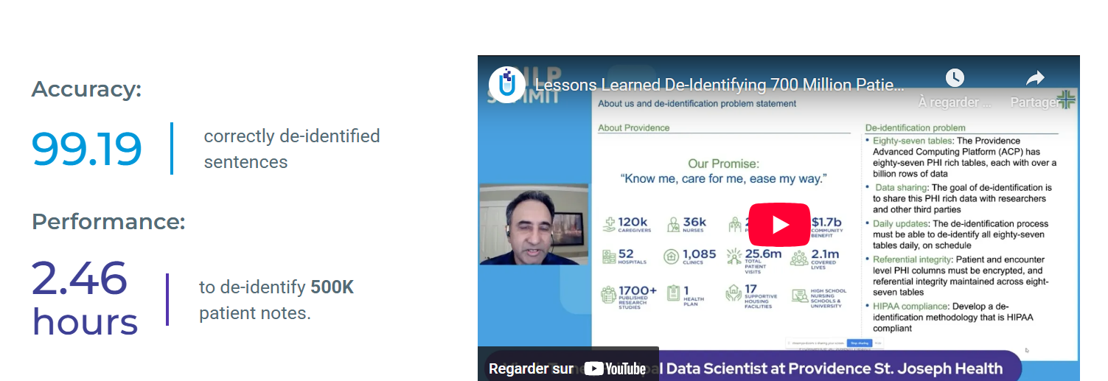
Providence Health Case Study: De-Identification of 700 Million Clinical Notes using Spark/Healthcare NLP
Lessons learned: https://www.nlpsummit.org/lessons-learned-de-identifying-700-million-patient-notes-with-spark-nlp/
4

Slide 5
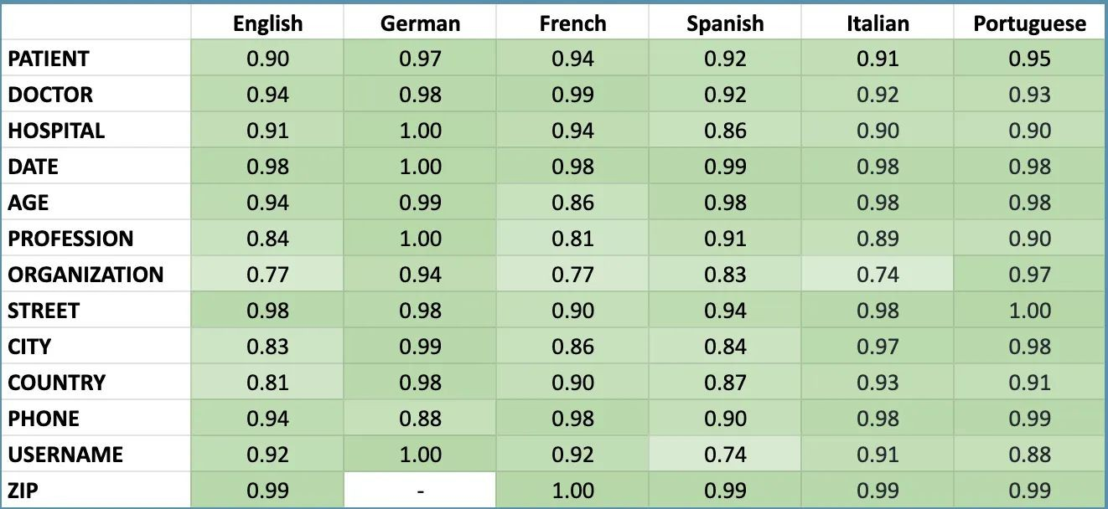
De-Identiffication Benchmarks (en)

Slide 6
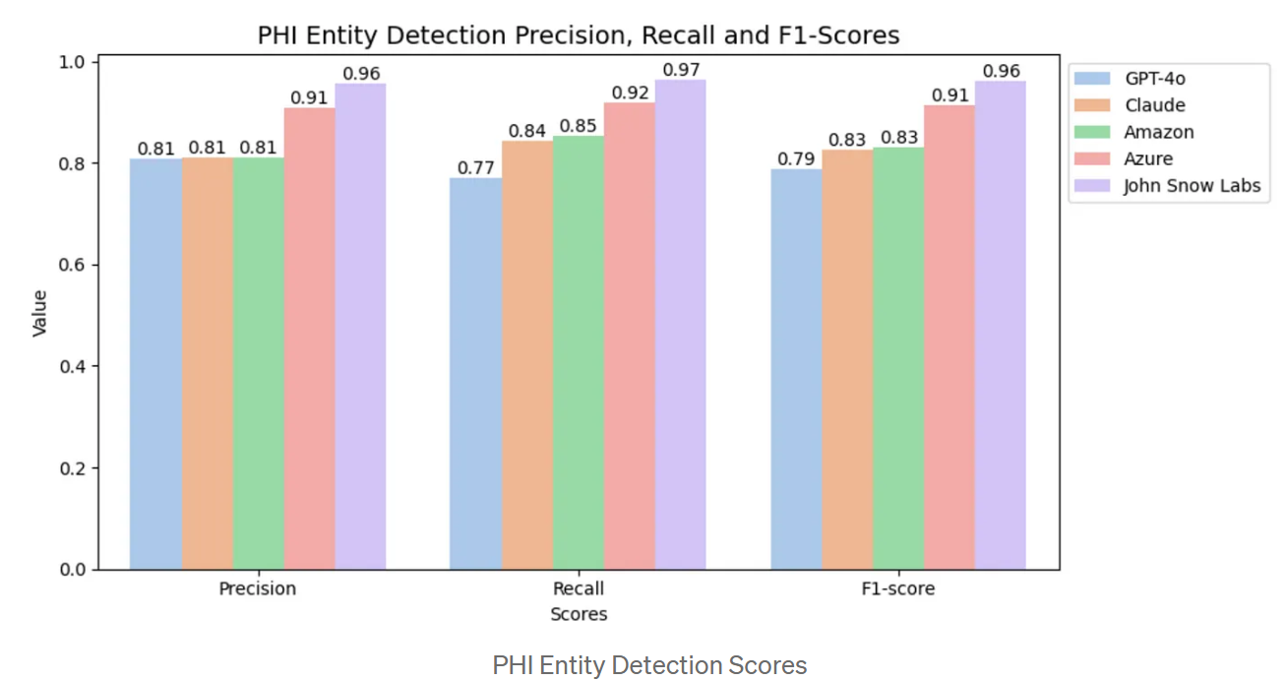
De-Identiffication Benchmarks (en)
Medium BlogPost: https://medium.com/john-snow-labs/comparing-de-identification-performance-healthcare-nlp-amazon-and-azure-47f17d185c87 Notebook: https://colab.research.google.com/github/JohnSnowLabs/spark-nlp-workshop/blob/master/tutorials/academic/DeIdentification_Benchmarks_Text2Story2025/Deidentification_Performance_Comparison_Of_Healthcare_NLP_VS_Cloud_Solutions.ipynb

Slide 7

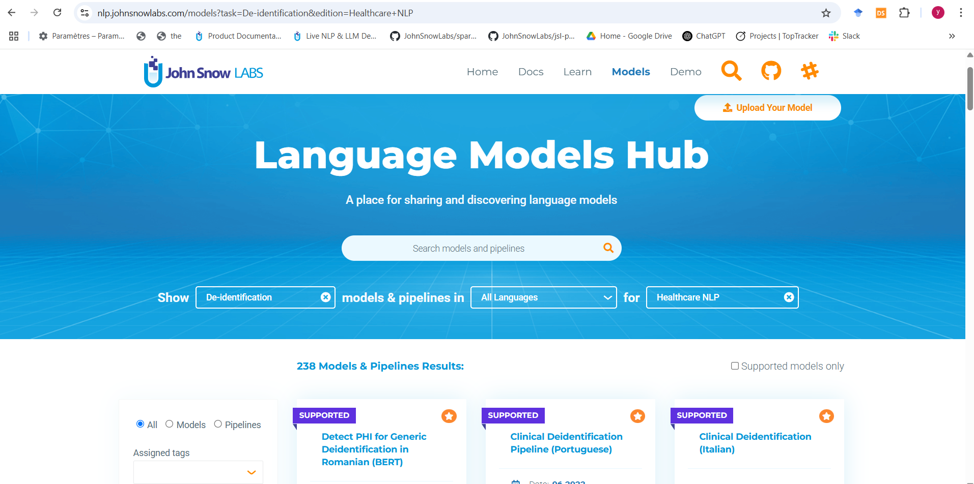
Resources: ModelsHub (Pipelines & Models)
ModelsHub link (Deidentification task): https://nlp.johnsnowlabs.com/models?task=De-identification&edition=Healthcare+NLP

Slide 8
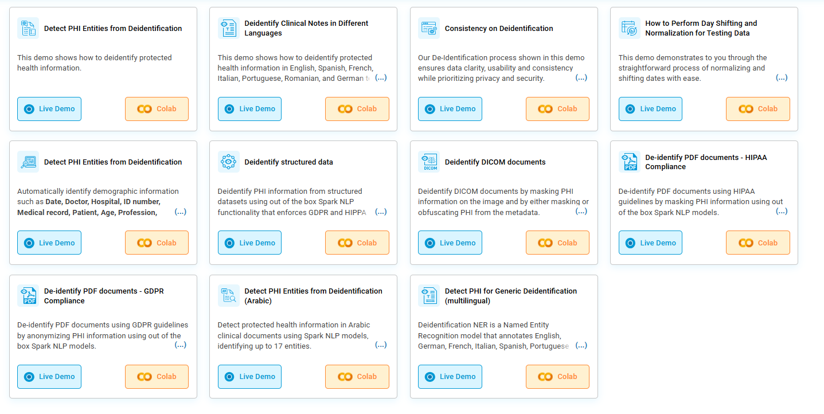
Resources: Demos
Demo page (Deidentification task): https://nlp.johnsnowlabs.com/deidentification

Slide 9
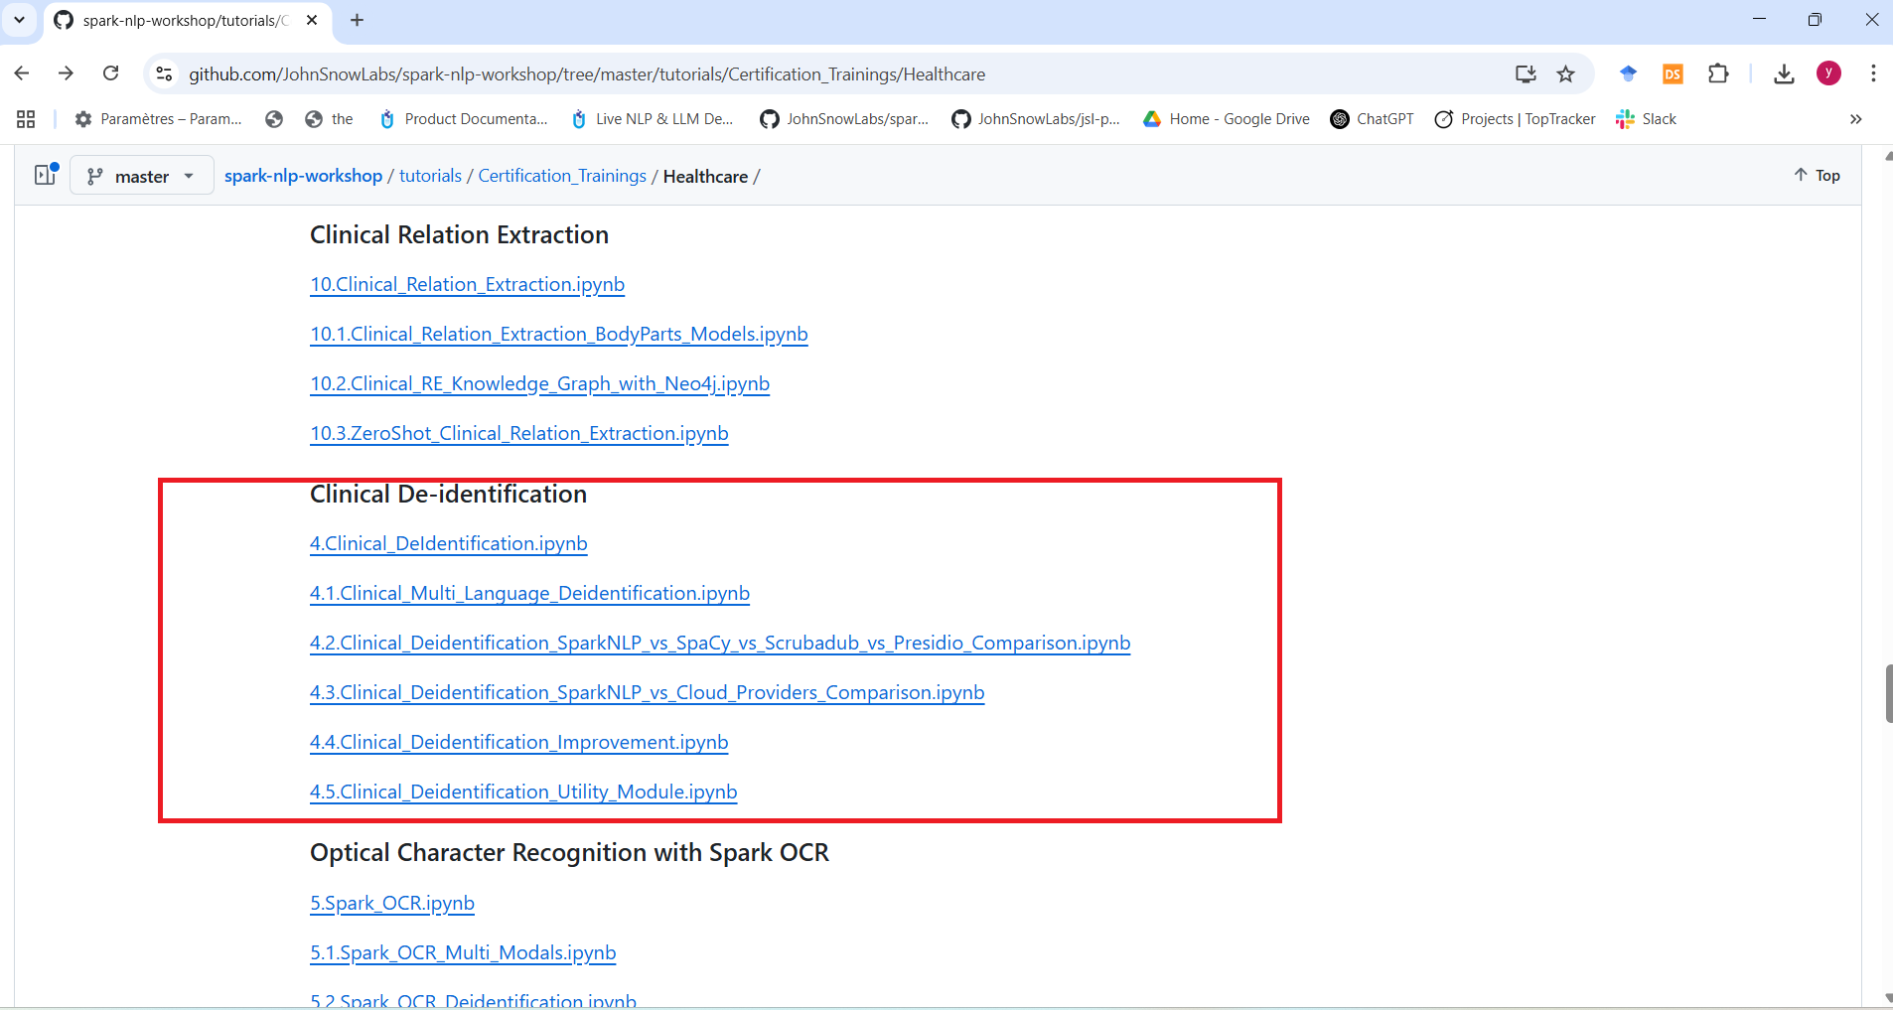
Resources: Notebooks (github repo)
Notebooks (Github repo): https://github.com/JohnSnowLabs/spark-nlp-workshop/tree/master/tutorials/Certification_Trainings/Healthcare#clinical-de-identification

Slide 10
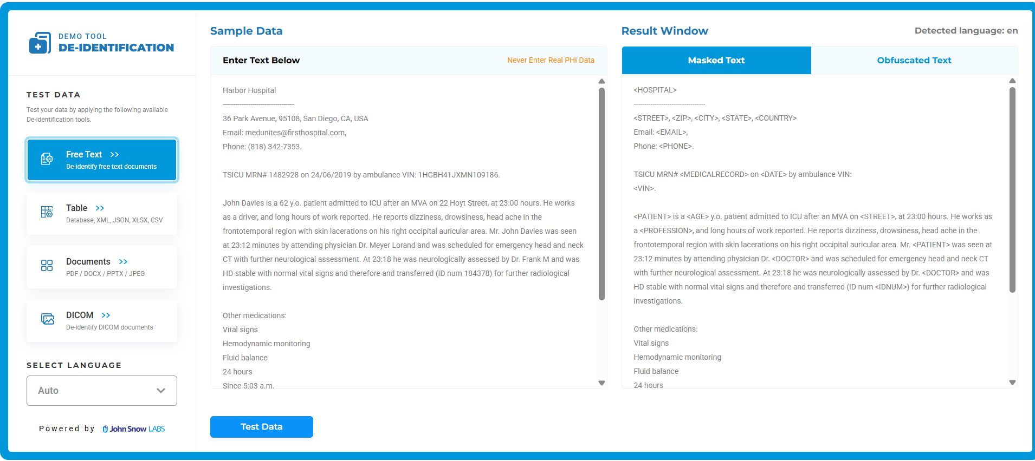
Resources: Live Deidentification tool: Free Text
Live deidentification tool link: https://deid.johnsnowlabs.com/

Slide 11
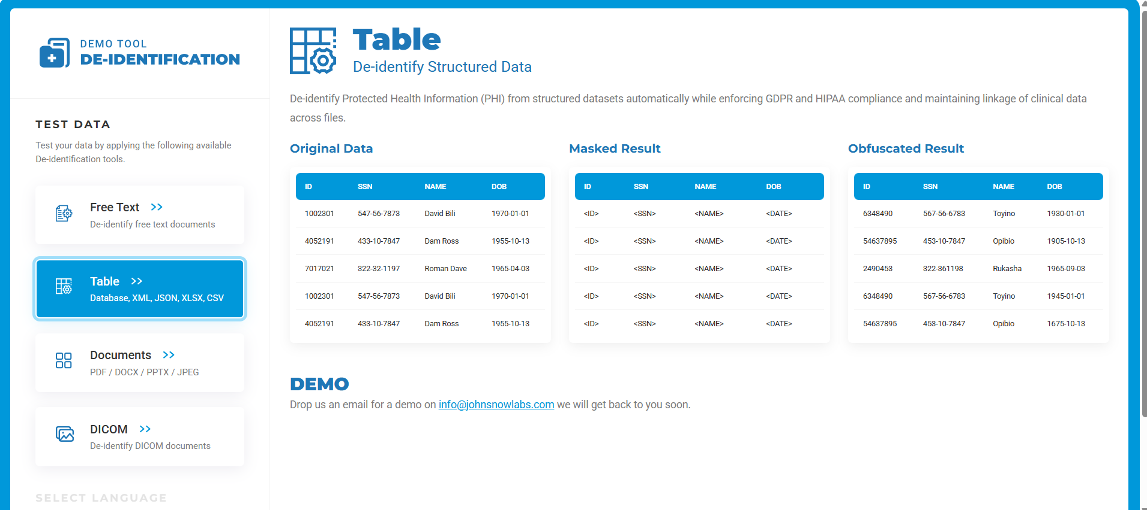
Resources: Live Deidentification tool: Structured data
Live deidentification tool link: https://deid.johnsnowlabs.com/

Slide 12
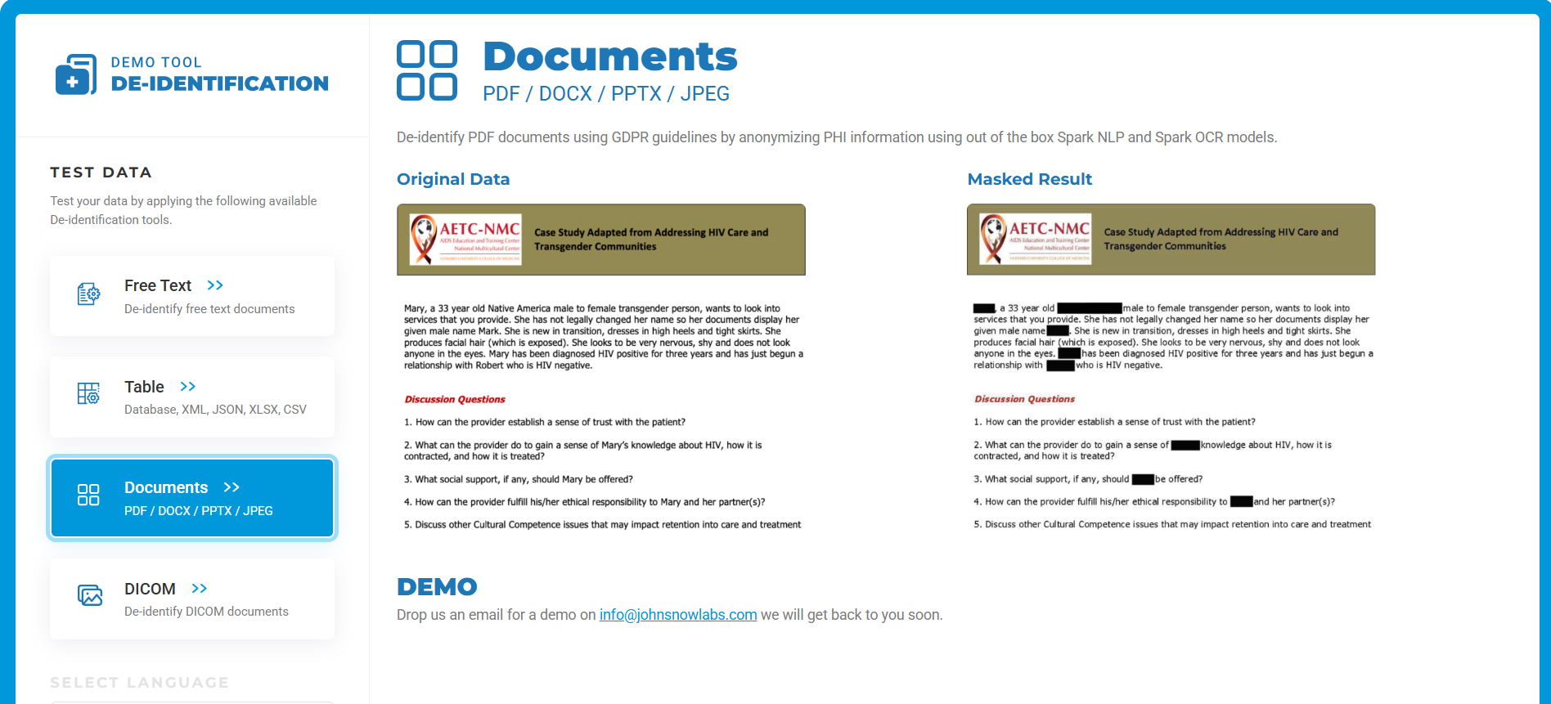
Resources: Live Deidentification tool: Documents (PDF, DOCX, JPEG..)
Live deidentification tool link: https://deid.johnsnowlabs.com/

Slide 13
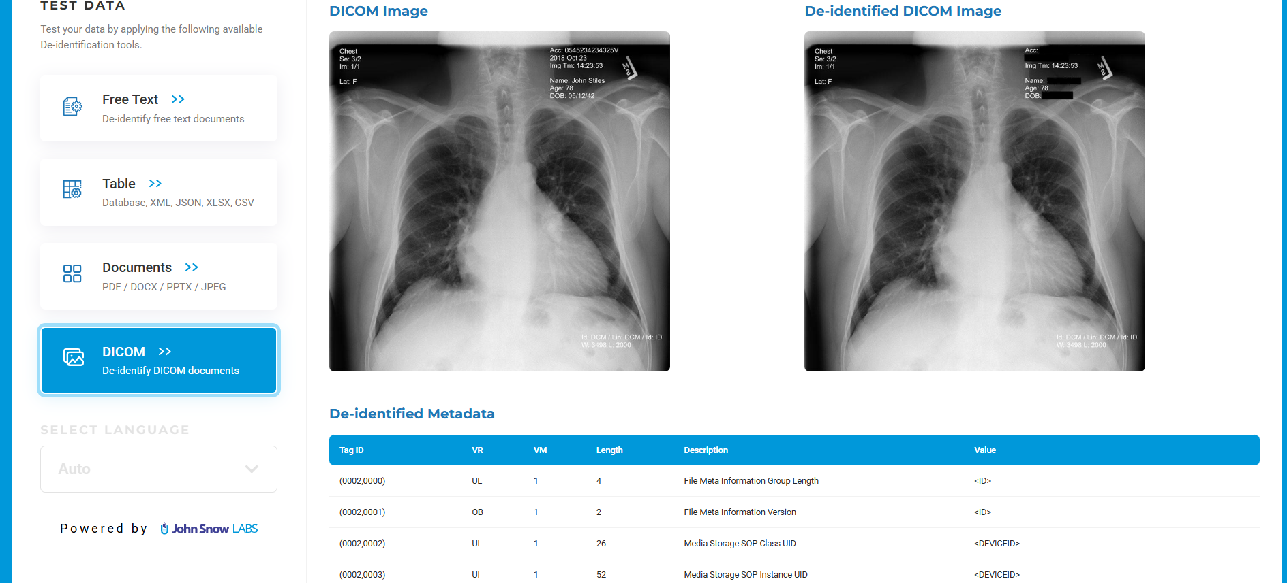
Resources: Live Deidentification tool: DICOM Image and Metadata
Live deidentification tool link: https://deid.johnsnowlabs.com/

Slide 14



Deidentification pipeline main components
Entity Extraction (NER)
Create a robust NER pipeline and extract PHI entities.
Merge Entities
Deidentiffication
Merge the entities coming from NER models by prioritizing.
Adjust the parameters of Deidentification annotator according to the needs.

Slide 15

Let’s code!
© 2015-2025 John Snow Labs Inc. All rights reserved. The John Snow Labs logo is a trademarks of John Snow Labs Inc. The included information is for informational purposes only and represents the current view of John Snow Labs as of the date of this presentation. Since John Snow Labs must respond to changing market conditions, it should not be interpreted to be a commitment on its part, and John Snow Labs cannot guarantee the accuracy of any information provided after the date of this presentation. John Snow Labs makes no warranties, express
or statutory, as to the information in this presentation.

